Slide 1

Mathematical Functions, Characters, and Strings
TUIT
C++ Programming, Fall 2016
Lecture #4
II - part

Slide 2
TUIT
Roadmap
Last week we covered
Selections
This week we will learn
Character Functions
Case Study: Converting a Hexadecimal Digit to a Decimal Value
Case Study: Revising the Lottery Program Using Strings
Formatting Console Output
Simple File and Output

Slide 3
TUIT
Character Functions
C++ contains the functions for working with characters.
Function | Description
isdigit(ch) | Returns true if the specified character is a digit
isalpha(ch) | Returns true if the specified character is a letter
isalnum(ch) | Returns true if the specified character is a letter of digit
islower(ch) | Returns true if the specified character is a lowercase letter
isupper(ch) | Returns true if the specified character is an uppercase letter
isspace(ch) | Returns true if the specified character is a whitespace character
tolower(ch) | Returns the lowercase of the specified character
toupper(ch) | Returns the uppercase of the specified character

Slide 4
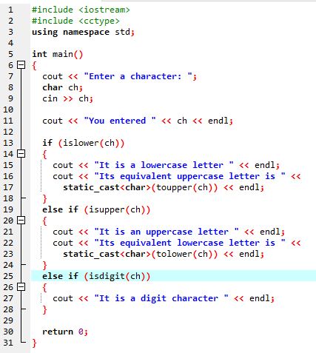


TUIT
Character Functions
Enter a character: a You entered a It is a lowercase letter Its equivalent uppercase letter is A
Enter a character: T You entered T It is an uppercase letter Its equivalent lowercase letter is t
Enter a character: 8 You entered 8 It is a digit character

Slide 5
TUIT
Check Point
Which function do you use to test whether a character is a digit? a letter? a lowercase letter? an uppercase letter? a digit or letter?
Which function do you use to convert a letter to lowercase or to uppercase?

Slide 6
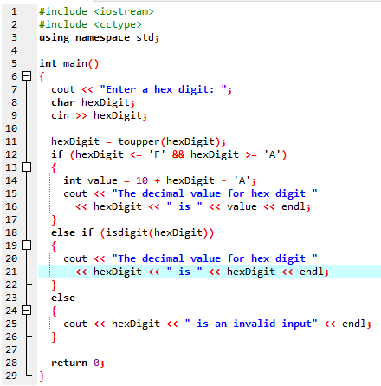
TUIT
Case Study: Converting a Hexadecimal Digit to a Decimal Value
Enter a hex digit: b The decimal value for hex digit B is 11
Enter a hex digit: B The decimal value for hex digit B is 11
Enter a hex digit: 8 The decimal value for hex digit 8 is 8
Enter a hex digit: T T is an invalid input

Slide 7
TUIT
Check Point
1. Which line in the code tests if the character is between ‘0’ and ‘9’?
2. If the input is f, what is the value displayed?

Slide 8
TUIT
The string Type
A string a sequence of characters. The char type represents only one character. To represent a string of characters, use the data type called string.
string message = “Programming is fun”;

Slide 9
TUIT
The string Type
Function | Description
length() | Returns the number of characters in this string
size() | Same as length().
at(index) | Returns the character at the specified index from this string.
string message = “ABCD”;
cout << message.length() << endl; // output 4
Cout << message.at(0) << endl; // output A
String s = “Bottom”;
cout << s.at(1); // output o

Slide 10
TUIT
Note
By default, a string is initialized to an empty string i.e., a string containing no characters. An empty string literal can be written as “”. Therefore, the following two statements have the same effect:
string s;
string s = “”;
To use the string type, you need to include the <string> header file in your program.

Slide 11
TUIT
String Index and Subscript Operator
Indices 0 1 2 3 4 5 6 7 8 9 10 11 12 13
Message
W | e | l | c | o | m | e |  | t | o |  | c | + | +
Message.at(0)
Message.length is 14
Message.at(13)

Slide 12
TUIT
Caution
Attempting to access characters in a string s out of bounds is a comment programming error. To avoid it, make sure that you not use an index beyond s, length() – 1. For example, s.at(s.length()) or s[s.length()] would cause an error.

Slide 13
TUIT
Concatenating Strings
C++ provides the + operator for concatenating two strings.
string s3 = s1 + s2;
The augmented += operator can also be used for string concatenation.
string message = “Welcome to C++”;
message += “ and programming is fun”;
You can also concatenate a character with a string.
string s = “ABC”;
s += ‘D’;
Therefore, the new s is “ABCD”.

Slide 14
TUIT
Caution
It is illegal to concatenate two string literals, For example, the following code is incorrect:
string cites = “London” + “Paris”;
However, the following code is correct, because it first concatenates string s with “London” and then the new string is concatenated with “Paris”.
string s = “New York”;
string cites = s + “London” + “Paris”

Slide 15
TUIT
Comparing Strings
You can use the relational operators ==, !=, <, <=, >, >= to compare two strings. This is done by comparing their corresponding characters one by one from left to right. For example,
string s1 = “ABC”;
string s2 = “ABE”;
cout << (s1 == s2) << endl;// Displays 0 (means false)
cout << (s1 != s2) << endl;// Displays 1 (means true)
cout << (s1 > s2) << endl; // Displays 0 (means false)
cout << (s1 >= s2) << endl;// Displays 0 (means false)
cout << (s1 <= s2) << endl;// Displays 1 (means true)
cout << (s1 <= s2) << endl;// Displays 1 (means true)

Slide 16
TUIT
Reading Strings
A string can be read from the keyboard using the cin object. For example:
string city;
cout << “Enter a city: ”;
cin >> city;
cout << “You entered ” << city << endl;
The input ends with a whitespace character.

Slide 17
TUIT
Reading Strings
C++ provides the getline function in the string header file, which reads a string from the keyboard using the following syntax:
getline(cin, s, delimitCharacter)
The third argument delimitCharacter has a default value (‘\n’).
string city;
cout << “Enter a city: ”;
getline(cin, city, ‘\n’); // Same as getline(cin, city)
cout << “You entered ” << city << endl;

Slide 18
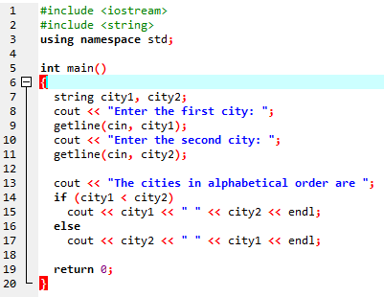
TUIT
Reading Strings
Enter the first city: New York Enter the second city: Boston The cities in alphabetical order are Boston New York

Slide 19
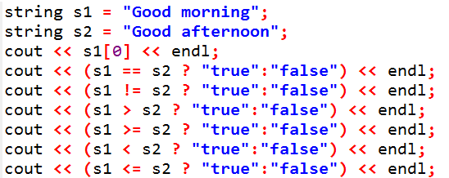
TUIT
Check Point
Show the output of the following code:

Slide 20
TUIT
Case Study: Revising the Lottery Program Using Strings
A problem can be solved using many different approaches. This section rewrites the lottery program in Lottery.cpp using strings. Using strings simplifies this program.
The lottery program generates a random two-digit number, prompts the user to enter a two-digit number, and determines whether the user wins according to the following rules:
If the user input matches the lottery number in the exact order, the award, the award is $10, 000.
If all the digits in the user input match all the digits in the lottery number, the award is $3,000.
If one digit in the user input matches a digit in the lottery number, the award is $1,000.

Slide 21
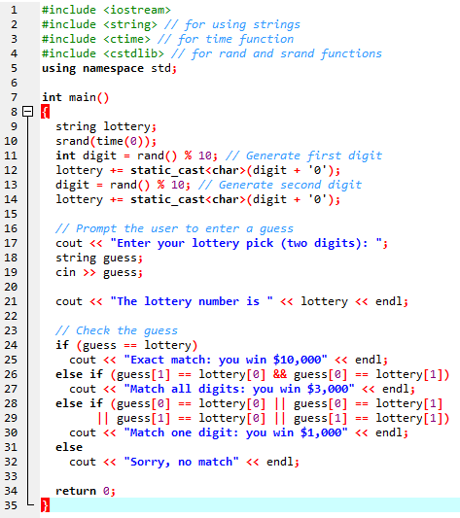
TUIT
Case Study: Revising the Lottery Program Using Strings
Enter your lottery pick(two digits):00 The lottery number is 00 Exact match: you win $10,000
Enter your lottery pick(two digits):45 The lottery number is 54 Match all digits: you win $3,000
Enter your lottery pick(two digits):23 The lottery number is 34 Match one digit: you win $1,000
Enter your lottery pick(two digits):23 The lottery number is 14 Sorry, no match

Slide 22
TUIT
Formatting Console Output
You can use the stream manipulators to display formatted output on the console.
double amount = 12618.98;
double interestRate = 0.0013;
double interest = amount * interestRate;
cout << “Interest is ” << interest << endl;
Interest is 16.4047

Slide 23
TUIT
Formatting Console Output
Because the interest amount is currency, it is desirable to display only two digits after the decimal point. To do this, you may write the code as follows:
double amount = 12618.98;
double interestRate = 0.0013;
double interest = amount * interestRate;
cout << “Interest is ”
<< static_cast<int> (interest * 100) / 100.0 << endl;
Interest is 16.4

Slide 24
TUIT
Formatting Console Output
However, the format is still not correct. There should be two digits after the decimal point (i.e., 16.40 rather than 16.4). You can fix it by using formatting functions, like this:
double amount = 12618.98;
double interestRate = 0.0013;
double interest = amount * interestRate;
cout << “Interest is ” << fixed << setprecision(2) << interest << endl;
Interest is 16.40

Slide 25
TUIT
Frequently Used Stream Manipulators
Operator | Description
setprecision(n) | Sets the precision of a floating-point number
fixed | Displays floating-point numbers in fixed-point notation
showpoint | Causes a floating-point number to be displayed with a decimal point with trailing zeros even if it has no fractional part
setw(width) | Specifies the width of a print field
left | Justifies the output to the left
right | Justifies the output to the right

Slide 26
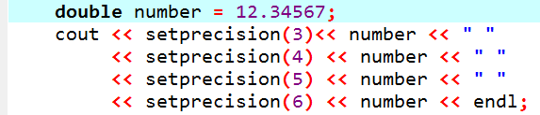
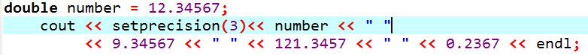
TUIT
setprecision(n) Manipulator
12.3 12.34 12.345 12.3456 12.34567
12.3 9.35 121 0.237
If the width is not sufficient for an integer, the setprecision manipulator is ignored. For example,
cout << setprecision(3) << 23456 << endl;//displays 23456

Slide 27
TUIT
fixed Manipulator
Sometimes, the computer automatically displays a large floating-point number in scientific notation. On the Windows machine, for example, the statement
cout << 232123434.357;
displays
2.32123e+08

Slide 28
TUIT
fixed Manipulator
Sometimes, the computer automatically displays a large floating-point number in scientific notation.
cout << 232123434.357; displays 2.32123e+08
cout << fixed << 232123434.357; displays 232123434.357000;
By default, the fixed number of digits after the decimal point is 6.

Slide 29
TUIT
fixed Manipulator
double monthlyPayment = 345.4567;
double totalPayment = 78676.887234;
cout << fixed << setprecision(2)
<< monthlyPayment << endl
<< totalPayment << endl;
Displays
345.46
78676.89

Slide 30
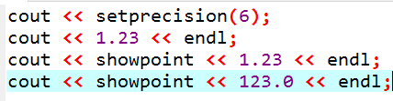
TUIT
showpoint Manipulator
Displays
1.23
1.23000
123.000

Slide 31
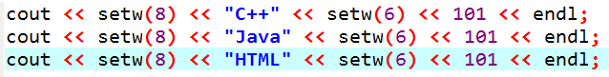
TUIT
setw(width) Manipulator
-----C++---101
----Java---101
----HTML---101
cout << setw(8) << “C++” << 101 <<endl;
-----C++101
cout << setw(8) << “Programming” << “#” << setw(2) << 101 ;
Programming#101

Slide 32
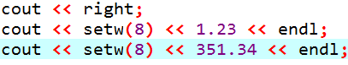
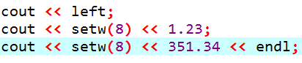
TUIT
left and right Manipulator
displays
----1.23
--351.34
displays
1.23----351.34--

Slide 33
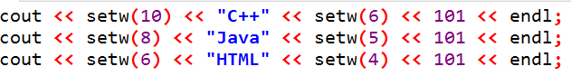
TUIT
Check Point
Show the output of the following statements.

Slide 34
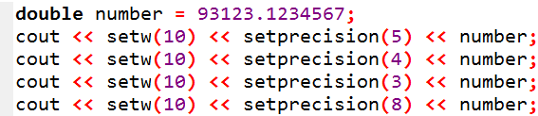
TUIT
Check Point
Show the output of the following statements.

Slide 35
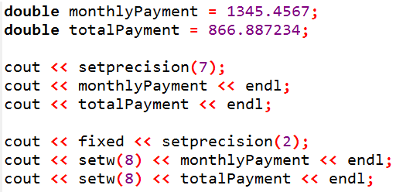
TUIT
Check Point
Show the output of the following statements:

Slide 36
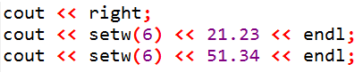
TUIT
Check Point
Show the output of the following statements:

Slide 37
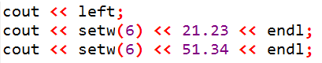
TUIT
Check Point
Show the output of the following statements:

Slide 38
TUIT
Simple File Input and Output
You can save data to a file and read data from the file later.
You used the cin to read input from the keyboard and the cout to write output to the console. You can also read/write data from/to a file.

Slide 39
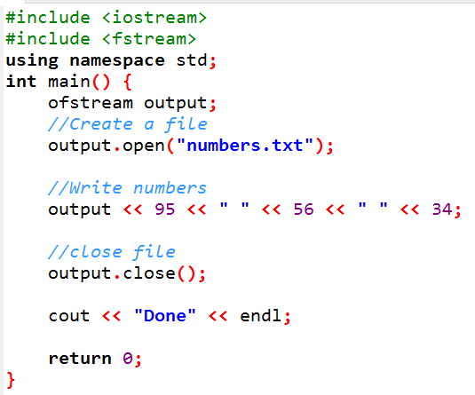
TUIT
Writing to a File

Slide 40
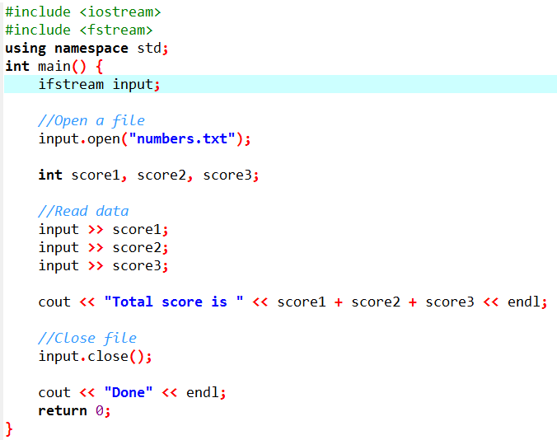
TUIT
Reading from a File

Slide 41
TUIT
Summary
C++ provides the functions isdigit, isalpha, isalnum, islower, isupper, isspace for testing whether a character is a digit, letter, digit or letter, lowercase, uppercase, and whitespace. It also contains the tolower and toupper functions for returning a lowercase or uppercase letter.
A string is a sequence of characeters. A string value is enclosed in matching double quotes(‘’). A character value is enclosed in matching single quotes (‘).
You can declare a string object using the string type. A function that is invoked from a specific object is called an instance function.
You can get the length of a string by invoking its length() function, and retrieve a character at the specific index in the string using the at(index).
You can use the relational operators to compare two strings.
You can use the relational operators to compare two strings.
You can format output using stream manipulators defined in the iomanip header.
You can create an ifstream object for reading data from a file and an ofstream object for writing data to a file

